Slide 1


Slide 2

Types of Data Collection
There are 4 types of data. Each data type has different data models:
Cross-sectional
Time-series
Panel
Pooled

Slide 3
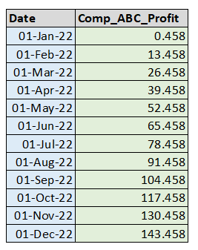
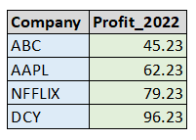
Types of Data Collection
Cross-sectional Data
Time-series Data

Slide 4
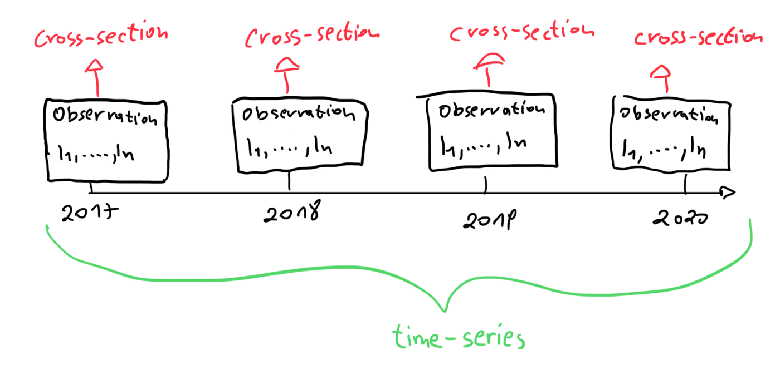
Types of Data Collection
Panel Data

Slide 5




Used to analyse before and after period of an event
Often collected in clinical trials.
Time intervals are generally irregular
Different data points can be recorded over multiple time frames.
Pooled Data

Slide 6
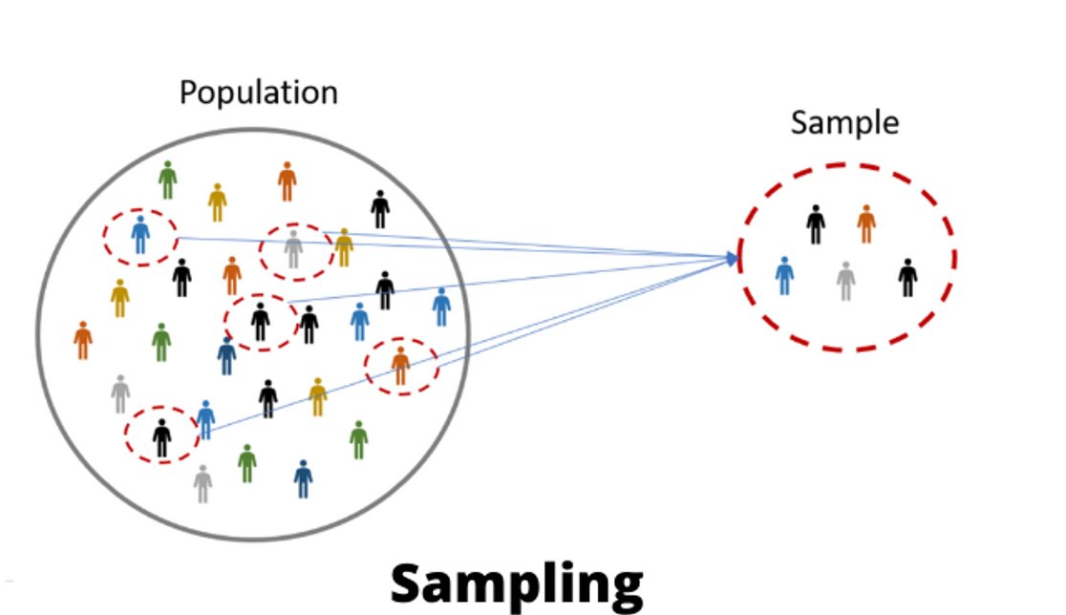
What is Data Sampling?
The practice of analyzing a subset of all data to uncover meaningful information in the larger data set.
Notes:
sampling is the practice of analyzing a subset of all data in order to uncover the meaningful information in the larger data set.
What do you think census is? Population or sample?

Slide 7
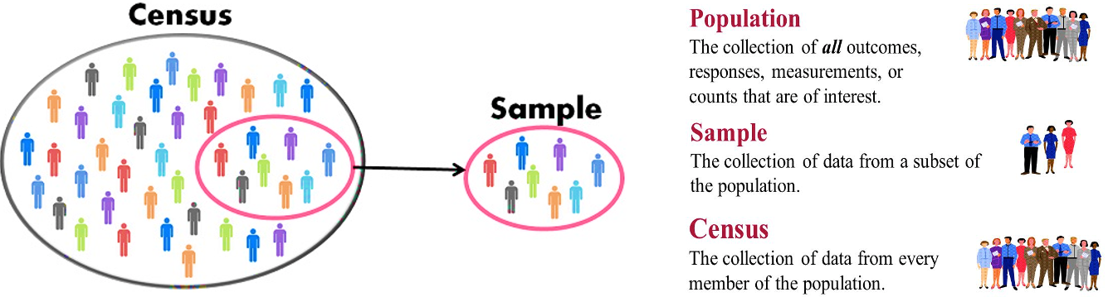
Census vs Sample

Slide 8
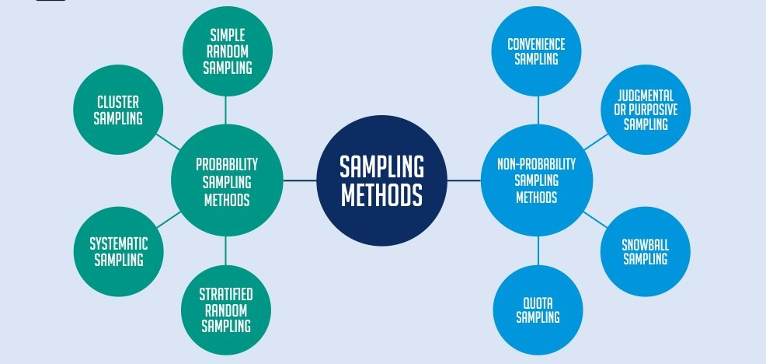
Types of Sampling
Two main types
probability of getting any particular sample may be calculated.
Can’t calculate the probability; not used for inference.

Slide 9
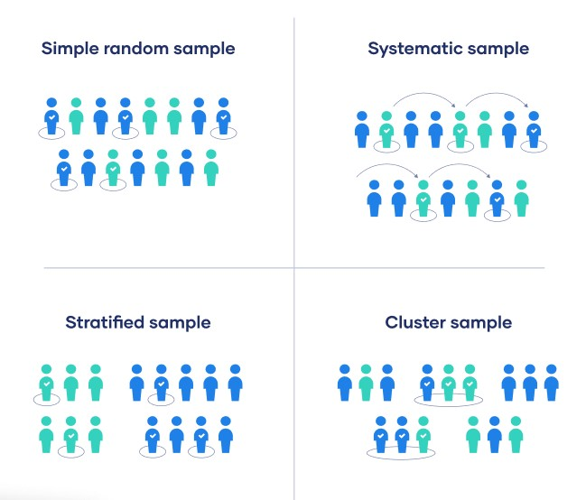
Probability Sampling
Notes:
Simple random >> every data point has equal chances of selection
Systematic >> assign a number to everyone and then take out people that have numbers divisible by 3 for example
Stratified sampling >> not naturally occurring but imposed by researcher. Take random sample within a strata. You must have sample from every strata >> mutually exclusive > this is done to improve representation
Cluster >> naturally occurring, select an entire cluster >> done to save time/resources

Slide 10
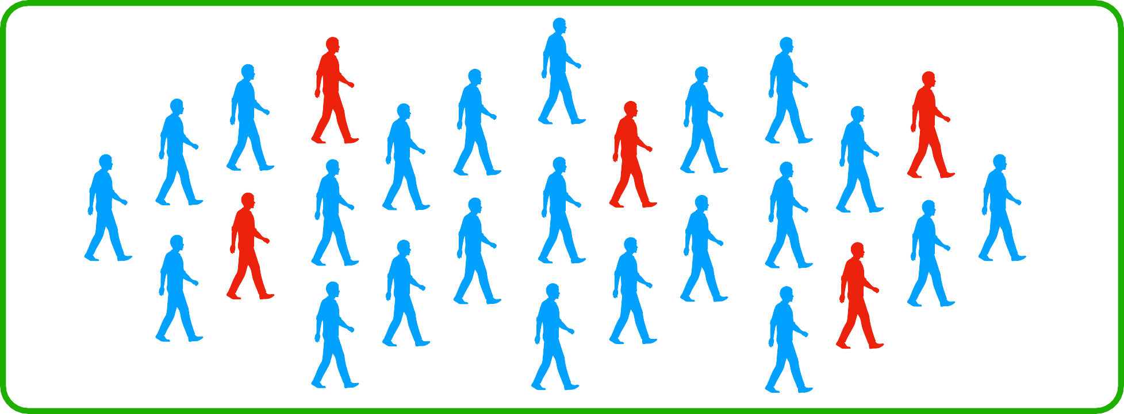
Simple Random Sampling (SRS)
Select n observations randomly from entire population
Each observation is likely to be selected
Notes:
Simple random >> every data point has equal chances of selection

Slide 11
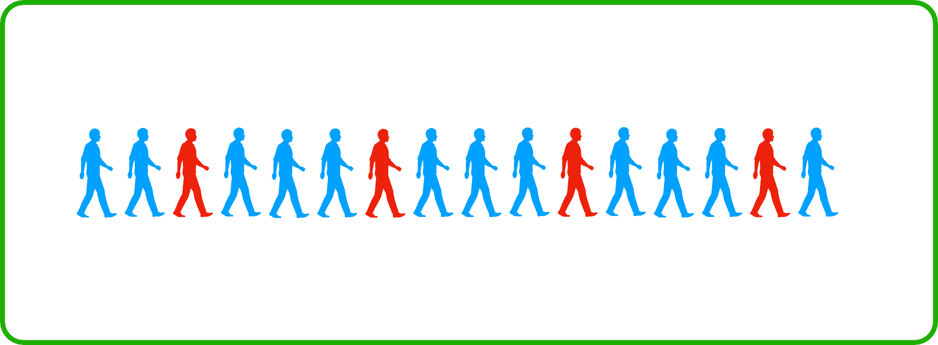
Systematic Sampling
Arrange the population according to some ordering
Start randomly and select every k^{th} observation
K = 4
Notes:
Systematic >> assign a number to everyone and then take out people that have numbers divisible by 3 for example

Slide 12
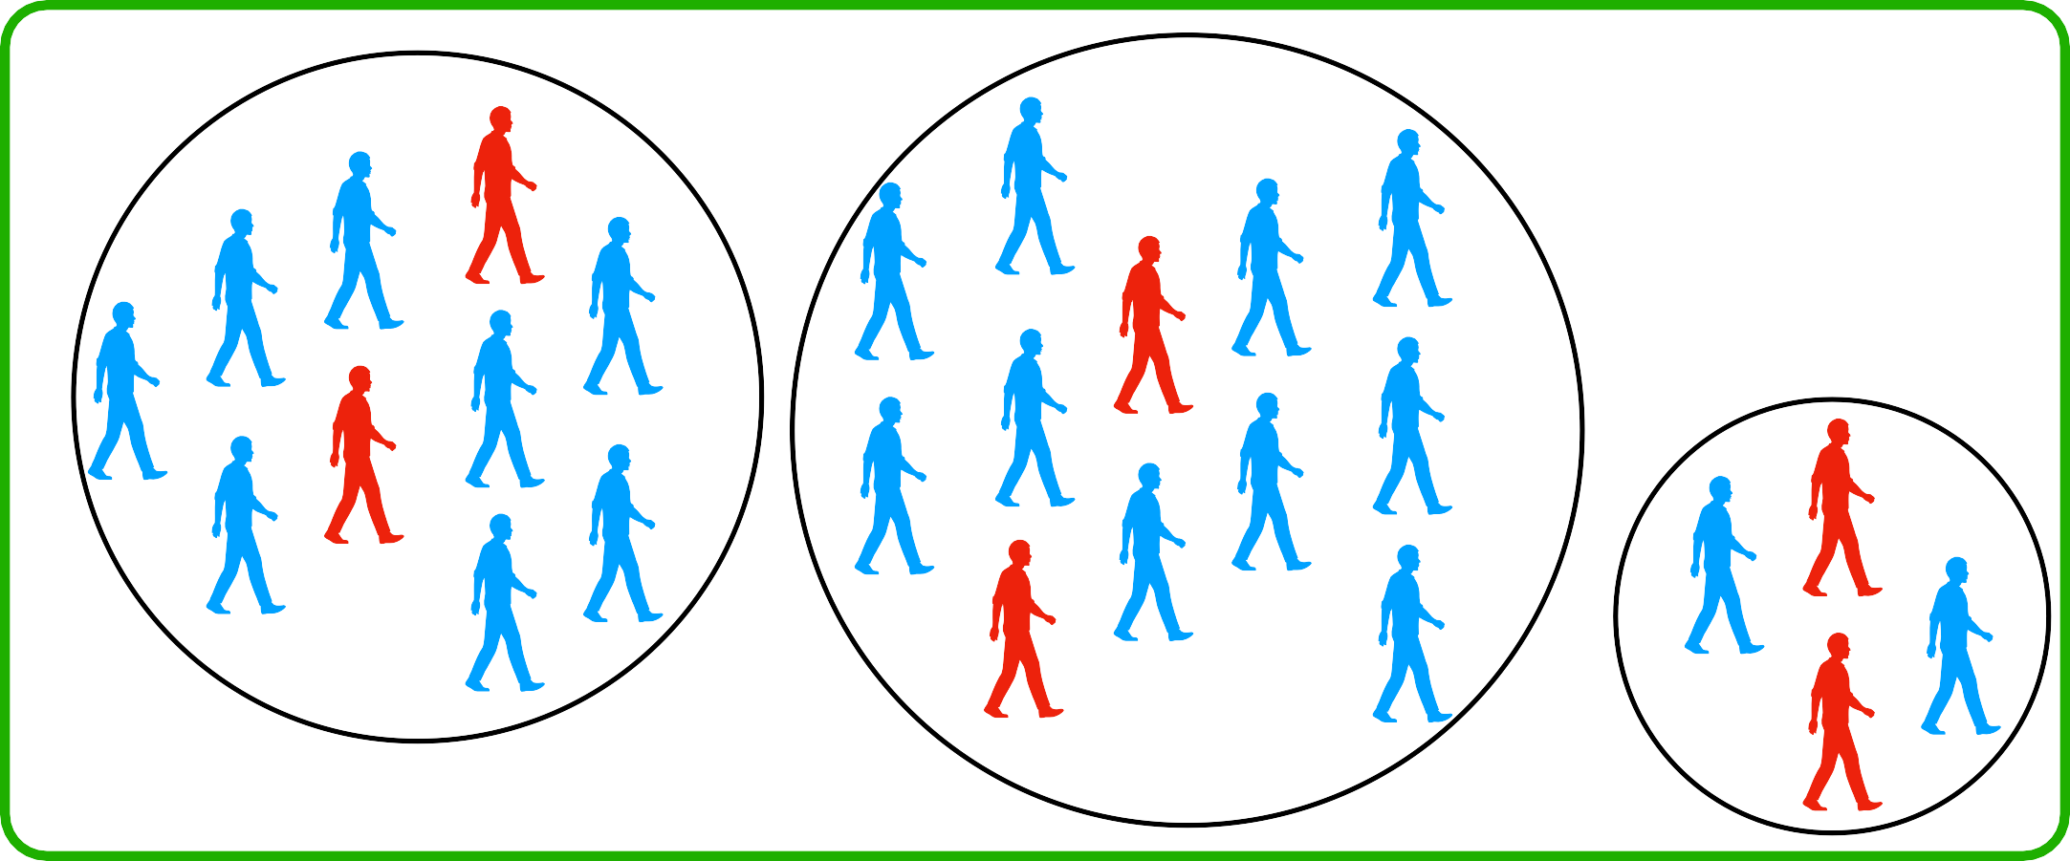
Stratified Sampling
Divide population in homogenous groups called strata
Do Simple Random Sampling (SRS) from each stratum
Stratum 2
Stratum 3
Stratum 1
Notes:
Stratified sampling >> not naturally occurring but imposed by researcher. Take random sample within a strata. You must have sample from every strata >> mutually exclusive > this is done to improve representation

Slide 13
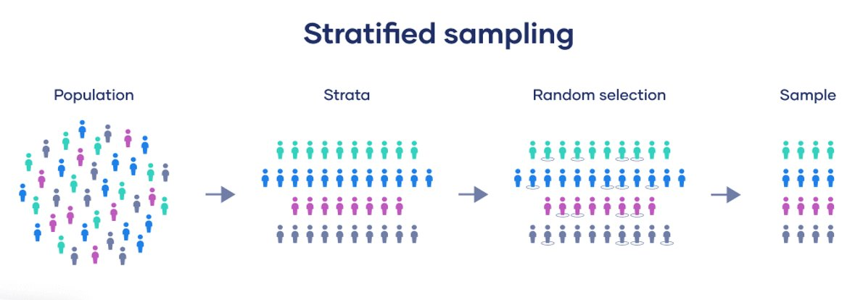

Slide 14
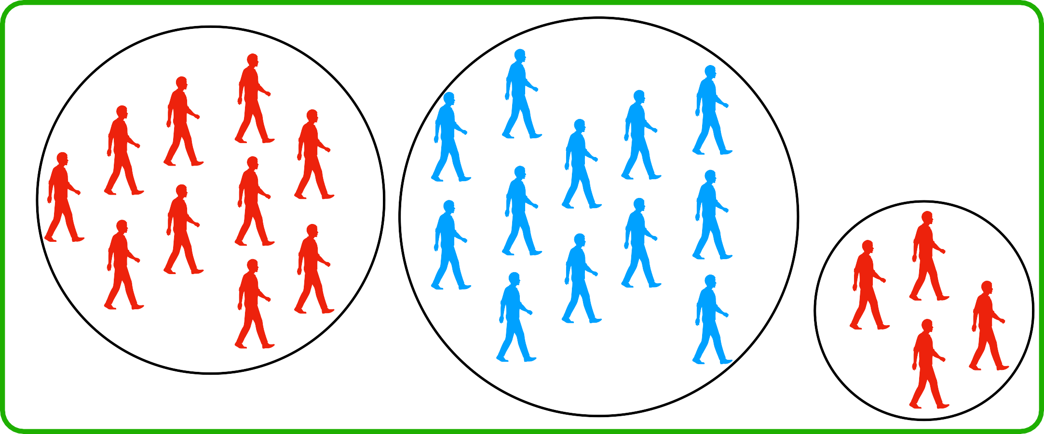
Clustered Sampling
Divide population in heterogenous groups called clusters
Randomly Sample k clusters; and sample all observations within those clusters
Cluster 2
Cluster 3
Cluster 1
Notes:
Cluster >> naturally occurring, select an entire cluster >> done to save time/resources

Slide 15
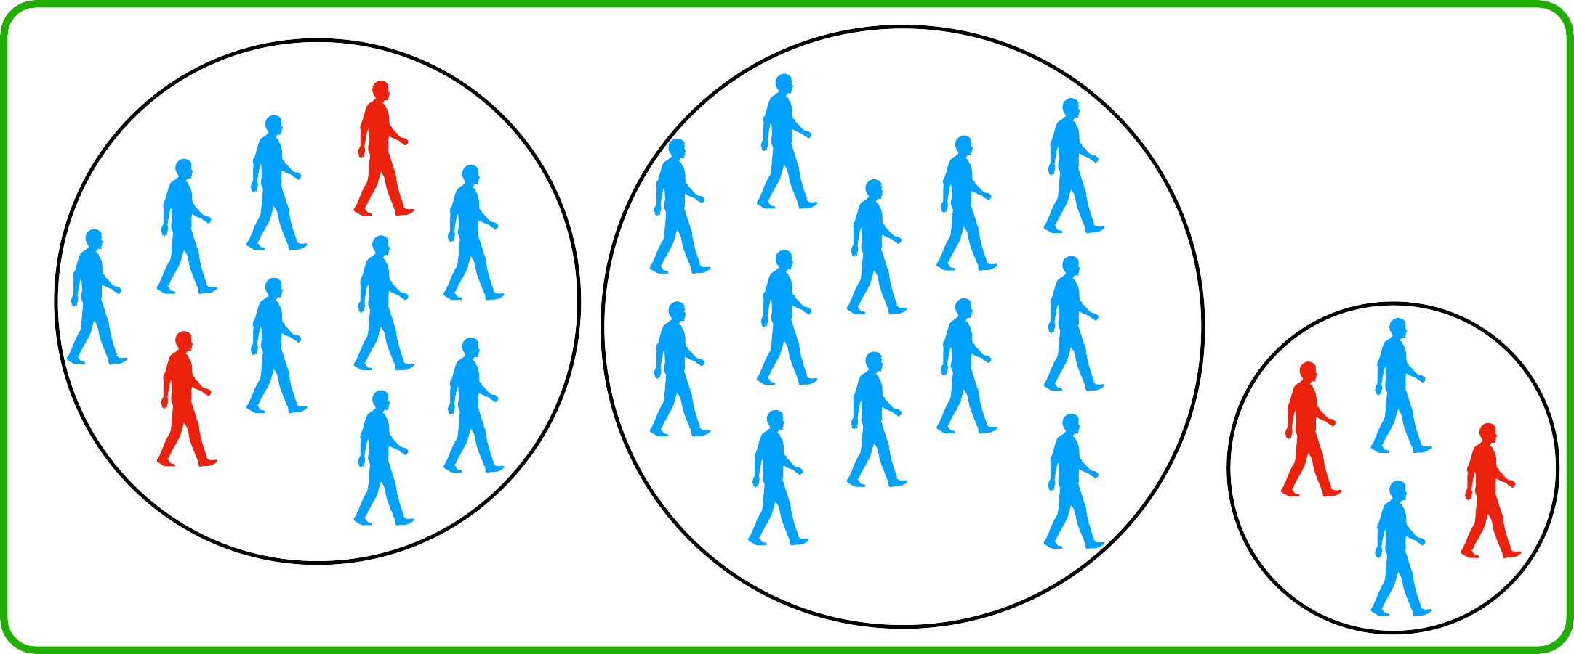
Multi-Stage Sampling
Divide population in heterogenous groups called clusters
Randomly Sample k clusters; and do SRS within those clusters
Cluster 2
Cluster 3
Cluster 1

Slide 16
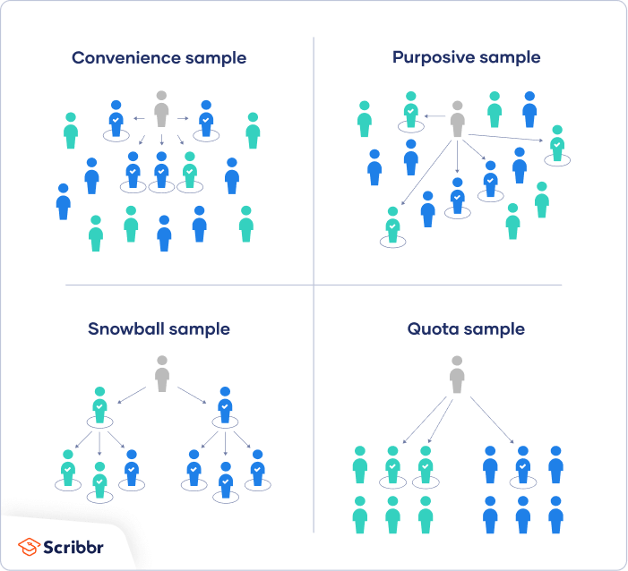
Non-Probability Sampling

Slide 17
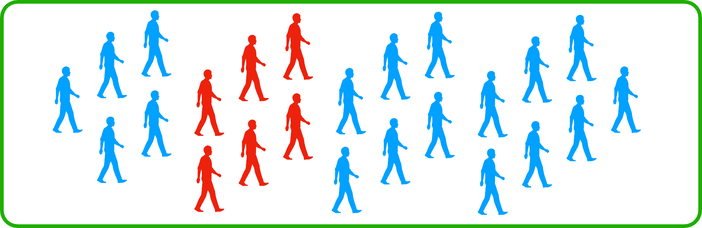
Convenience/Accidental Sampling
Members of the population are chosen based on their relative ease of access.
To sample friends, co-workers, or shoppers at a single mall, are all examples of convenience sampling.
Notes:
Members of the population are chosen based on their relative ease of access.
To sample friends, co-workers, or shoppers at a single mall, are all examples of convenience sampling.
Such samples are biased because researchers may unconsciously approach some kinds of respondents and avoid others (Lucas 2014a), and respondents who volunteer for a study may differ in unknown but important ways from others (Wiederman 1999).

Slide 18
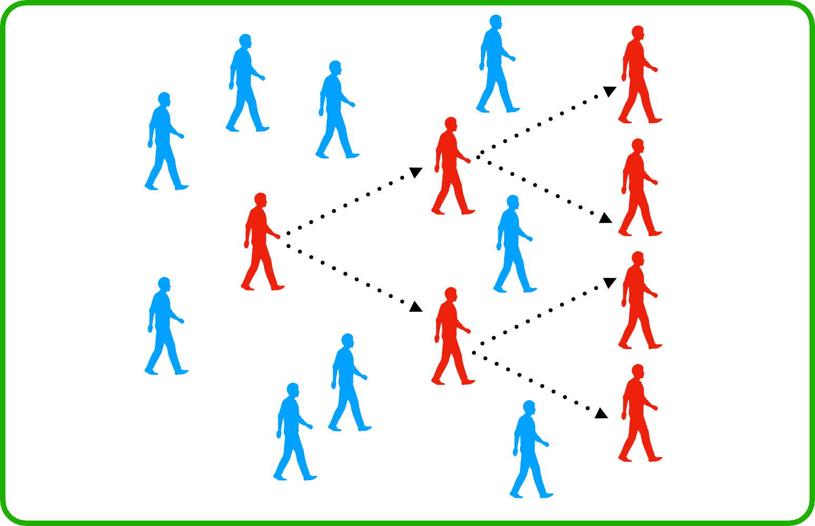
Snowball Sampling
The first respondent refers an acquaintance.
The friend also refers a friend, and so on.
Notes:
The first respondent refers an acquaintance. The friend also refers a friend, and so on.
Such samples are biased because they give people with more social connections an unknown but higher chance of selection (Berg 2006), but lead to higher response rates.

Slide 19
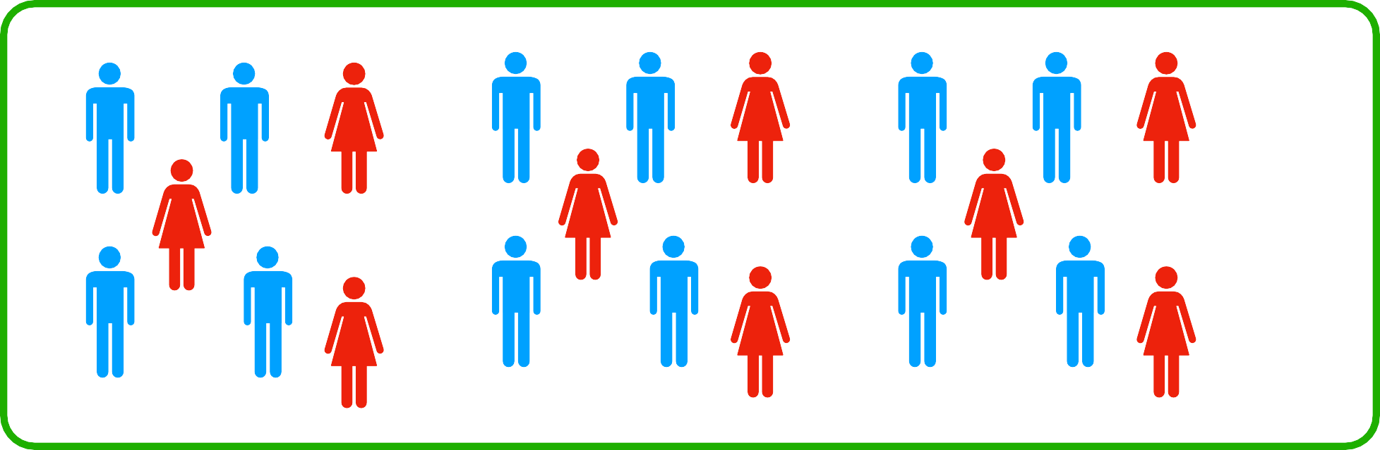
Purposive/Judgmental Sampling
The researcher chooses the sample based on who they think would be appropriate for the study.
This is used primarily when the interest of the research is on a specific field or a small group.
Notes:
The researcher chooses the sample based on who they think would be appropriate for the study.
This is used primarily when there is a limited number of people that have expertise in the area being researched, or when the interest of the research is on a specific field or a small group.

Slide 20
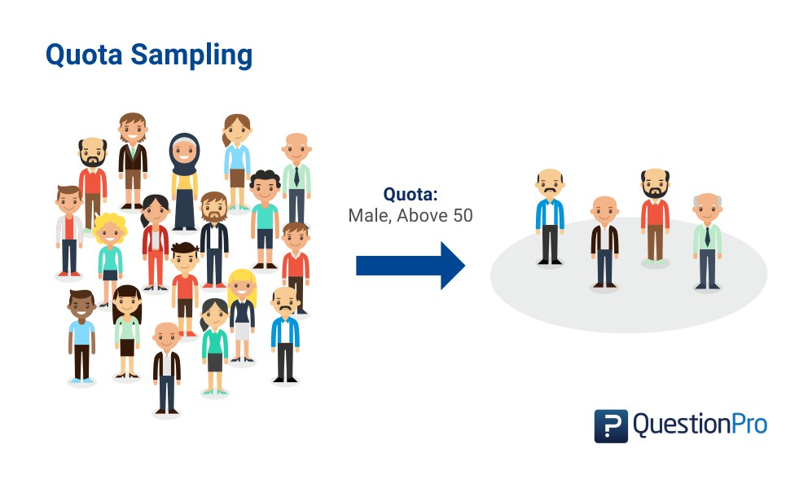
Quota Sampling?
Notes:
Ask the audience, what they can understand about quota sampling shown in the image
Quota sampling is defined as a non-probability sampling method in which researchers create a sample involving individuals that represent a population. Researchers choose these individuals according to specific traits or qualities. They decide and create quotas so that the market research samples can be useful in collecting data.

Slide 21
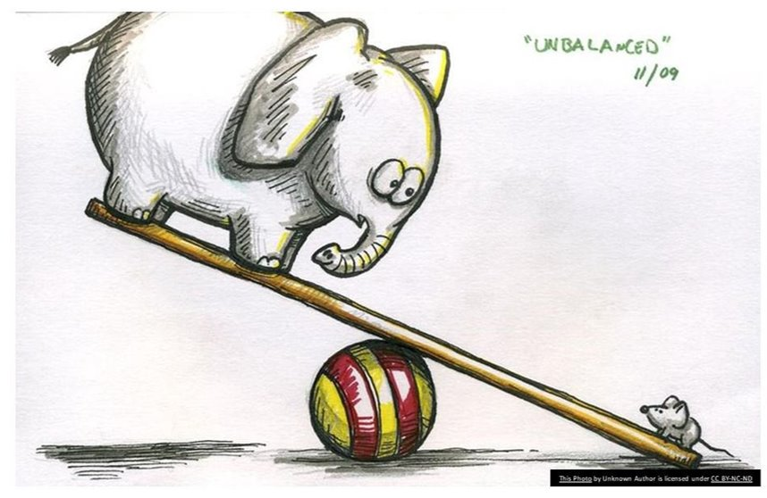
Class Imbalance
Notes:
Imbalanced datasets are a special case for classification problem where the class distribution is not uniform among the classes. Typically, they are composed by two classes: The majority (negative) class and the minority (positive) class
Imbalanced datasets can be found for different use cases in various domains:
Finance: Fraud detection datasets commonly have a fraud rate of ~1–2%
Ad Serving: Click prediction datasets also don’t have a high clickthrough rate.
Transportation/Airline: Will Airplane failure occur?
Medical: Does a patient has cancer?
Content moderation: Does a post contain NSFW content?

Slide 22
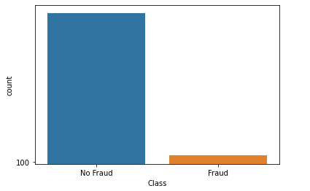
Class Imbalance

Slide 23
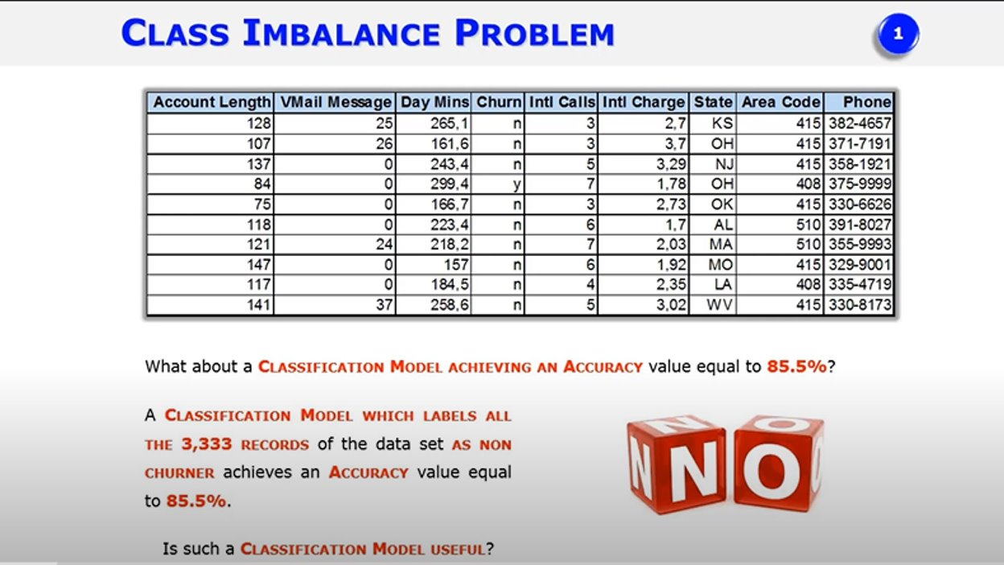
Class Imbalance
Notes:
https://www.youtube.com/watch?v=TjiKhzsUwWA&ab_channel=FabioStella

Slide 24
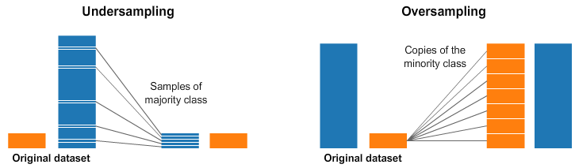
How to handle Class Imbalance
Notes:
A widely adopted and perhaps the most straightforward method for dealing with highly imbalanced datasets is called resampling. It consists of removing samples from the majority class (under-sampling) and/or adding more examples from the minority class (over-sampling).

Slide 25
Data Assumptions & Conditions
Linearity in parameters (Only holds for Linear regression)
Variables follow normal distribution (random sampling)
No multicollinearity
No heteroscedasticity (constant variance)
Avoid misspecification error
Avoid omitted variable bias
Variable precision
No influential outliers
Notes:
Statistical models such as linear regression is built upon Ordinary Least Square method that works on certain assumptions to compute unbiased estimates of explanatory variables.
Moreover, there are many models that are influenced by the presence of outliers, misspecified or unprecise measurement of variables and omission of important parameters.

Slide 26

THANK YOU
Training and Certification

